Slide 1
RAID
Redundant Array of Inexpensive Disks or Redundant Array of Independent Drives.

Slide 2
RAID
performance and/or reliability of data storage
A RAID system consists of two or more drives working in parallel
Parallelism can also be used to perform several independent reads or writes in parallel.
improving the reliability of data storage, because redundant information can be stored on multiple disks

Slide 3
RAID levels:
RAID 0 – striping
RAID 1 – mirroring
RAID 5 – striping with parity
RAID 6 – striping with double parity
RAID 10 – combining mirroring and striping
https://www.prepressure.com/library/technology/raid

Slide 4
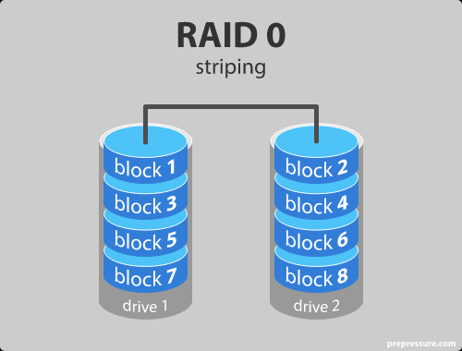
RAID level 0 – Striping
In a RAID 0 system data are split up into blocks that get written across all the drives in the array. By using multiple disks (at least 2) at the same time, this offers superior I/O performance

Slide 5
RAID level 0
Advantages
RAID 0 offers great performance, both in read and write operations. There is no overhead caused by parity controls.
All storage capacity is used, there is no overhead.
The technology is easy to implement.
Disadvantages
RAID 0 is not fault-tolerant. If one drive fails, all data in the RAID 0 array are lost. It should not be used for mission-critical systems.
Ideal use
RAID 0 is ideal for non-critical storage of data that have to be read/written at a high speed, such as on an image retouching or video editing station.

Slide 6
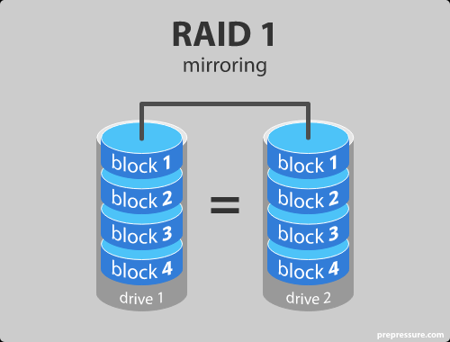
RAID level 1 – Mirroring
Data are stored twice by writing them to both the data drive (or set of data drives) and a mirror drive (or set of drives). If a drive fails, the controller uses either the data drive or the mirror drive for data recovery and continues operation. You need at least 2 drives for a RAID 1 array.

Slide 7
RAID level 1 – Mirroring
Advantages
RAID 1 offers excellent read speed and a write-speed that is comparable to that of a single drive.
In case a drive fails, data do not have to be rebuild, they just have to be copied to the replacement drive.
RAID 1 is a very simple technology.
Disadvantages
The main disadvantage is that the effective storage capacity is only half of the total drive capacity because all data get written twice.
Software RAID 1 solutions do not always allow a hot swap of a failed drive. That means the failed drive can only be replaced after powering down the computer it is attached to. For servers that are used simultaneously by many people, this may not be acceptable. Such systems typically use hardware controllers that do support hot swapping.
Ideal use
RAID-1 is ideal for mission critical storage, for instance for accounting systems. It is also suitable for small servers in which only two data drives will be used.

Slide 8
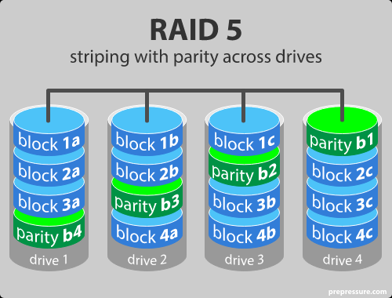
RAID level 5
RAID 5 is the most common secure RAID level. It requires at least 3 drives but can work with up to 16. Data blocks are striped across the drives and on one drive a parity checksum of all the block data is written. The parity data are not written to a fixed drive, they are spread across all drives, as the drawing below shows.

Slide 9
RAID level 5
Advantages
Read data transactions are very fast while write data transactions are somewhat slower (due to the parity that has to be calculated).
If a drive fails, you still have access to all data, even while the failed drive is being replaced and the storage controller rebuilds the data on the new drive.
Disadvantages
Drive failures have an effect on throughput, although this is still acceptable.
This is complex technology. If one of the disks in an array using 4TB disks fails and is replaced, restoring the data (the rebuild time) may take a day or longer, depending on the load on the array and the speed of the controller. If another disk goes bad during that time, data are lost forever.
Ideal use
RAID 5 is a good all-round system that combines efficient storage with excellent security and decent performance. It is ideal for file and application servers that have a limited number of data drives.

Slide 10
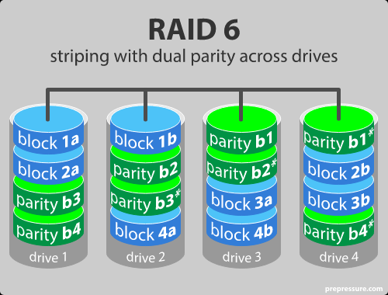
RAID level 6 – Striping with double parity
RAID 6 is like RAID 5, but the parity data are written to two drives. That means it requires at least 4 drives and can withstand 2 drives dying simultaneously. The chances that two drives break down at exactly the same moment are of course very small.

Slide 11
RAID level 6 – Striping with double parity
Advantages
Like with RAID 5, read data transactions are very fast.
If two drives fail, you still have access to all data, even while the failed drives are being replaced. So RAID 6 is more secure than RAID 5.
Disadvantages
Write data transactions are slower than RAID 5 due to the additional parity data that have to be calculated. In one report I read the write performance was 20% lower.
Drive failures have an effect on throughput, although this is still acceptable.
This is complex technology. Rebuilding an array in which one drive failed can take a long time.
Ideal use
RAID 6 is a good all-round system that combines efficient storage with excellent security and decent performance. It is preferable over RAID 5 in file and application servers that use many large drives for data storage.

Slide 12
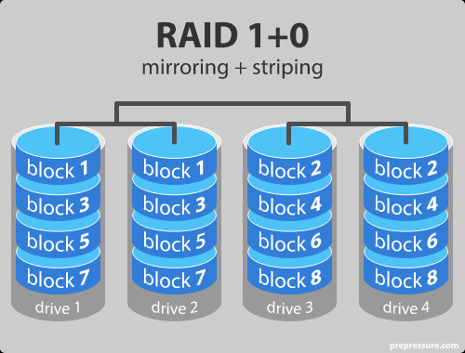
RAID level 10 – combining RAID 1 & RAID 0
It is possible to combine the advantages (and disadvantages) of RAID 0 and RAID 1 in one single system. This is a nested or hybrid RAID configuration. It provides security by mirroring all data on secondary drives while using striping across each set of drives to speed up data transfers.

Slide 13
RAID level 10
Advantages
If something goes wrong with one of the disks in a RAID 10 configuration, the rebuild time is very fast since all that is needed is copying all the data from the surviving mirror to a new drive. This can take as little as 30 minutes for drives of 1 TB.
Disadvantages
Half of the storage capacity goes to mirroring, so compared to large RAID 5 or RAID 6 arrays, this is an expensive way to have redundancy.

Slide 14
What about RAID levels 2, 3, 4 and 7?
These levels do exist but are not that common
RAID level 2, known as memory-style error-correcting-code (ECC) organization
RAID level 3, bit-interleaved parity organization
• RAID level 4, block-interleaved parity organization
(RAID 3&4 is essentially like RAID 5 but with the parity data always written to the same drive).

Slide 15
RAID is no substitute for back-up!
All RAID levels except RAID 0 offer protection from a single drive failure. A RAID 6 system even survives 2 disks dying simultaneously. For complete security, you do still need to back-up the data from a RAID system.
That back-up will come in handy if all drives fail simultaneously because of a power spike.
It is a safeguard when the storage system gets stolen.
Back-ups can be kept off-site at a different location. This can come in handy if a natural disaster or fire destroys your workplace.
The most important reason to back-up multiple generations of data is user error. If someone accidentally deletes some important data and this goes unnoticed for several hours, days or weeks, a good set of back-ups ensure you can still retrieve those files.

